Slide 1
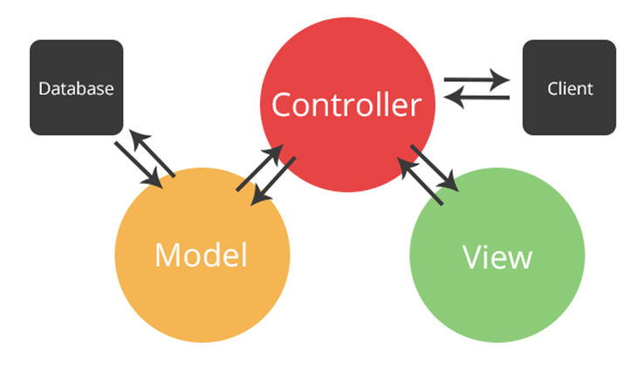
PHP: Web Operations
MVC Architecture, Routing
Software University
http://softuni.bg
SoftUni Team
Technical Trainers

Slide 2
Contents
MVC Concepts
Overview, Purpose
URL
Routing

Slide 3
Have a Question?
sli.do
#php-web

Slide 4
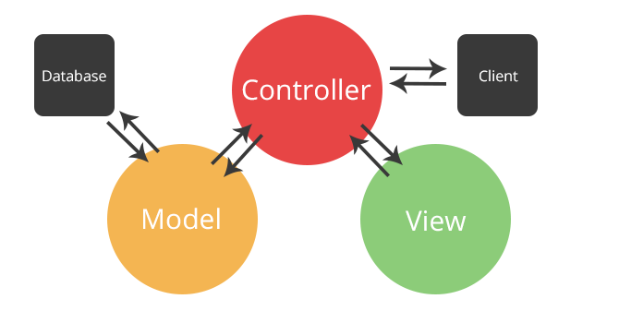
MVC
Overview, Purpose

Slide 5
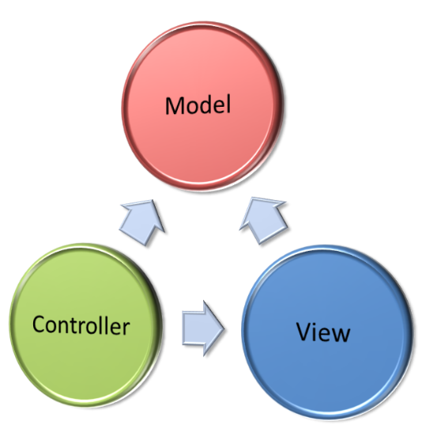
Model-View-Controller (MVC)
Model-View-Controller (MVC) is a software architecture pattern
Originally formulated in the late 1970s by Trygve Reenskaug
Code reusability and separation of concerns
Originally developed for desktop
Then adapted for internet applications

Slide 6

The MVC Pattern
Design pattern with three independent components
Model (data)
Manages data and database logic
View (UI)
Presentation layer (renders the UI)
Controller (logic)
Implements the application logic
Processes user request, performs an action, updates the data model and invokes a view to render some UI

Slide 7
Model (Data)
Set of classes that describes the data we are working with
Rules for how the data can be changed and manipulated
May contain data validation rules
Often encapsulates data stored in a database
As well as code used to manipulate the data
E.g. Data Access Layer of some kind

Slide 8

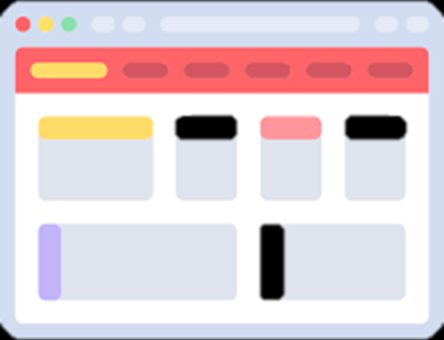

View (UI)
Defines how the application’s user interface (UI) will be displayed
May support master views (layouts)
May support sub-views (partial views or controls)
May use templates to dynamically generate HTML

Slide 9
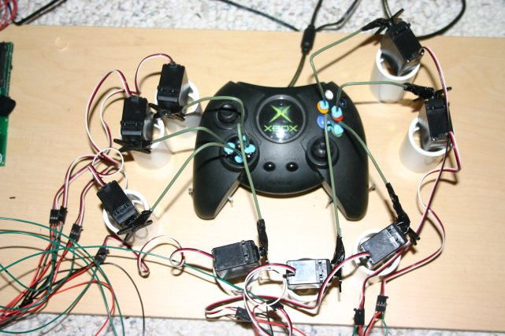
Controller (Logic)
The core MVC component – holds the logic
Process the requests with the help of views and models
A set of classes that handles
Communication from the user
Overall application flow
Application-specific logic (business logic)
Every controller has one or more "actions"

Slide 10

URL
Uniform Resource Locator

Slide 11
Uniform Resource Locator (URL)
http://mysite.com:8080/demo/index.php?id=27&lang=en#lectures
Protocol
Host
Port
Path
Query String
Fragment
Protocol for communicating (http, ftp, https...) – HTTP in most cases
Host or IP address (www.softuni.bg, gmail.com, 127.0.0.1, web)
Port (the default port is 80) – a number in range [0…65535]
Path (/forum, /path/index.php)
Query string (?id=27&lang=en)
Fragment (#lectures) – used on the client to navigate to some section

Slide 12
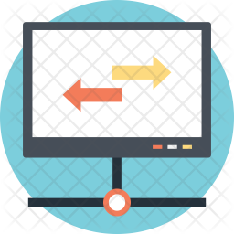
Routing

Slide 13
What Is a Route?
Routing is the process of taking a URI endpoint (that part of the URI which comes after the base URL) and decomposing it into parameters to determine which module, controller, and action of that controller should receive the request.
These URL do not have to map to specific files on a website. The best thing about these URL is that they are both human readable and SEO friendly.

Slide 14
URL Rewrite
.htaccess
<IfModule mod_rewrite.c>
RewriteEngine On
RewriteRule ^ index.php
</IfModule>

Slide 15
URL Rewrite (2)
$uri = $_SERVER['REQUEST_URI']; var_dump($uri);

Slide 16
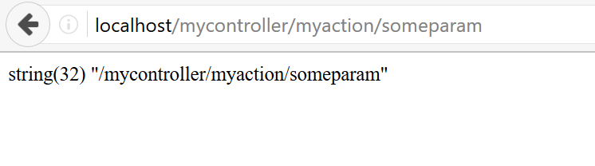
URL Rewrite (3)

Slide 17
URL Rewrite (4)
$uri = $_SERVER['REQUEST_URI']; $self = explode("/", $_SERVER['PHP_SELF']); array_pop($self); $replace = implode("/", $self); $uri = str_replace($replace."/", "", $uri);
Replace Nested Folders

Slide 18
URL Rewrite (5)
$params = explode("/", $uri); $controllerName = array_shift($params); $actionName = array_shift($params); var_dump($controllerName); var_dump($actionName); var_dump($params);

Slide 19
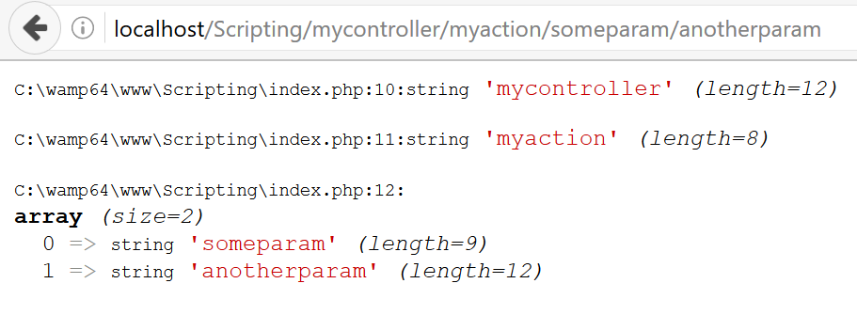
URL Rewrite (6)

Slide 20
Example - Demo
.htaccess
RewriteEngine On
RewriteCond %{REQUEST_FILENAME} !-f
RewriteCond %{REQUEST_FILENAME} !-d
RewriteRule ^$ index.php [L]
RewriteRule (.*) index.php?r=$1 [QSA,L]

Slide 21
index.php
function route($regex, $cb) {
$regex = str_replace('/', '\/', $regex);
$is_match = preg_match('/^' . ($regex) . '$/', $_SERVER['REQUEST_URI'], $matches, PREG_OFFSET_CAPTURE);
if ($is_match) { $cb($matches); }
}
route('/blog/', function($matches) { /* your handler */ } );
route('/blog/tag/(.*)', function($matches) {
var_dump( $matches );
});

Slide 22
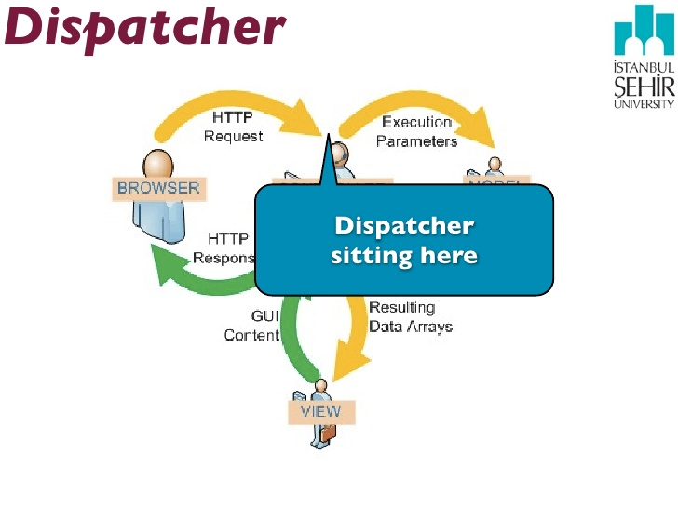
Dispatching

Slide 23
Dispatching
Print “Hello World” when /hello/world is accessed. Print “Hello Software University” when /hello/softuni is accessed.

Slide 24
Dispatching (2)
if ($controllerName == "hello") { switch ($actionName): case "world": echo "Hello World"; break; case "softuni"; echo "Hello Software University"; break; endswitch; }

Slide 25
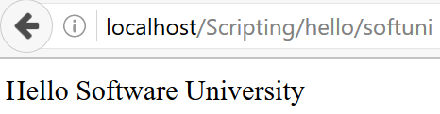
Dispatching (3)

Slide 26
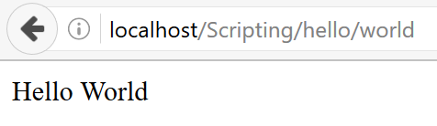
Dispatching (4)

Slide 27

Summary
…
…
…
MVC
Popular design pattern (architectural model)
Runs most of the Web apps
Code is organized into Models, Views and Controllers
URL
Routing

Slide 29













SoftUni Diamond Partners

Slide 30





SoftUni Organizational Partners

Slide 31




Trainings @ Software University (SoftUni)
Software University – High-Quality Education and Employment Opportunities
softuni.bg
Software University Foundation
http://softuni.foundation/
Software University @ Facebook
facebook.com/SoftwareUniversity
Software University Forums
forum.softuni.bg

Slide 32

License
This course (slides, examples, demos, videos, homework, etc.) is licensed under the "Creative Commons Attribution-NonCommercial-ShareAlike 4.0 International" license

